Slide 1

Welcome to FireFlight!
Meet the Team:
Our team is composed of:
  Alyssa Ortiz- Team Lead, Hosting, Frontend
  Payton Watts- Data Querying, Backend
  Andrew Ortega- Web Development, Frontend
  Tyler Chapp- Data Visualization, Backend
Our clients:
  USDA Forest Service researchers
  NAU SICCS researchers
Mentor: Scott LaRocca
The main focus of this project is to predict the reaction of birds to fires in their habitats, as birds are incredibly reflective of the overall health and recovery of an ecosystem.
Notes:
Payton
Time: Less than a minute (<60 seconds) (current time is around 1min & 7sec)

Slide 2

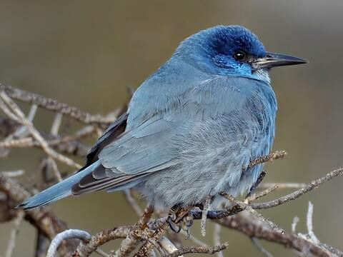
Problem Statement
Clients: Analyze data to determine likelihood of bird presence in an area post-fire
  Birds are an indicator species of an ecosystems health
  Valuable data for Western United States Forestry Management Stations
Clients currently produce and distribute all data + analysis manually
Need a user friendly tool to easily view and export the data on bird presence in an area
Notes:
Alyssa slow down!!!!
Time: ~2 minutes (around 120 seconds) (current time is around 1min & 20-30sec)
Our clients analyze reported data on bird sightings in an area to determine the likelihood of bird presence in a given area
For example, at a certain spot, there could be a 30% chance that crows will be present.
This is important because birds are an indicator species that reflect an ecosystem’s health.
To determine which course of actions are best to take, scientists need to first look at how bird populations change in response to natural disasters, especially wildfires.
This data analysis is used by Western United States Forestry Management Stations to help them determine how to properly take care of an area.
Currently, all stations must go through a single point to receive user-friendly analysis for over 10 years of collected data- our clients
They are producing and distributing all of this information manually each time a station requests data.
They need a a user friendly tool that they, and all of the research stations, can use to easily view and export the data on bird presence in an area
Each research station should be able to view and export the collected data on their own, and be able to understand the results in order to increase individual efficiency and free up our clients to work on other important projects, rather than dedicating lots of time to relaying information back and forth

Slide 3
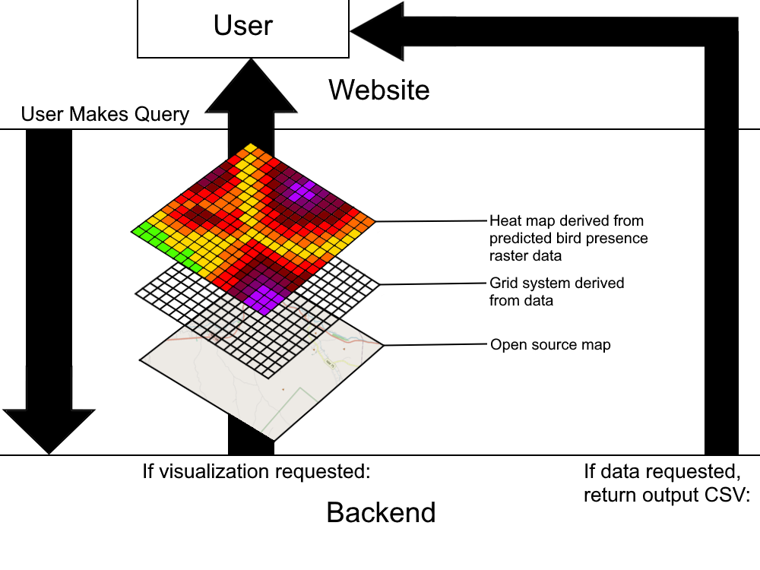
Solution Overview-
What we’re building is a web app that allows users to query a database for bird presence prediction data, receiving it either as a CSV file, heat map, or both.
Notes:
Payton
Time: ~30-45 seconds (current time is around 1min & 15sec for this slide alone)

Slide 4
Solution Overview- Cont.
Key features:
  Ease of access- users need an easy way to retrieve data/maps.
  Easy querying- users should be able to filter the data by species, region, etc.
  Clear visualization- heat maps and data files must be able to clearly visualize what the user wishes to show to forest managers and other officials.
  Security- due to being proprietary USDA information, the database must be safe and protected from cyber threats.
  Built for Future Maintenance- Our code must be readable, instructions for usage clear, and codebase easily maintainable.
Notes:
Given that we will be handing off this project to a government agency for possibly long-term use…
Payton
Time: ~1:15 to 1:30 (current time is around 1min & 55sec for this slide alone)

Slide 5
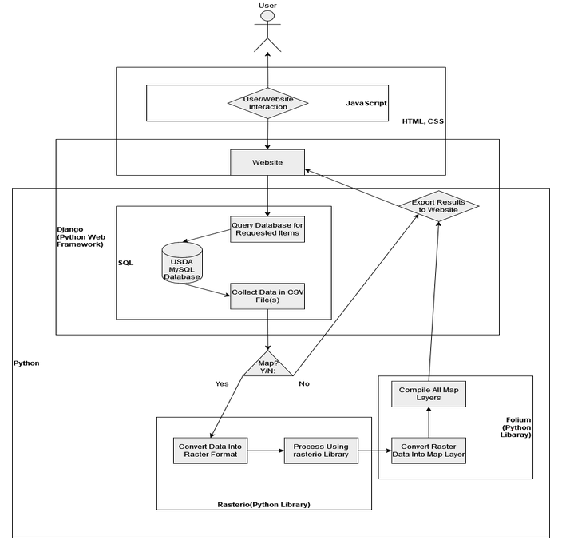
Implementation Overview
User Interface
  HTML/CSS/JavaScript
  Bootstrap
Application Logic
  Django
Mapping & Visualization
  Raster.io & Folium
Database Layer
  MySQL
Notes:
Tyler
Time: ~ 1 minute
Architecture of System’s Modules:
User Interface: easy to use for non-technical users, built with HTML/CSS, JavaScript, and Bootstrap
Guarantees a user-friendly experience
Application Logic: Read in data from CSV, export filtered data into CSV. Django to handle back-end functions
Robust, secure back-end that is in python and aligns with other modules easily
Mapping & Visualization: Raster.io, and Folium to process data, generate maps, and apply overlays.
Python Ecosystem: allows rapid development of complex visualizations
Database Layer: MySQL managed by Django

Slide 6
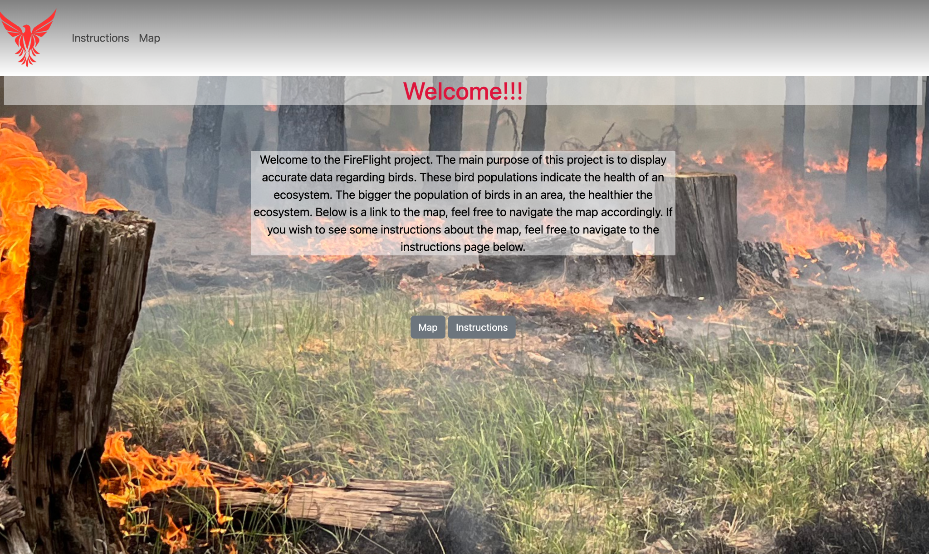
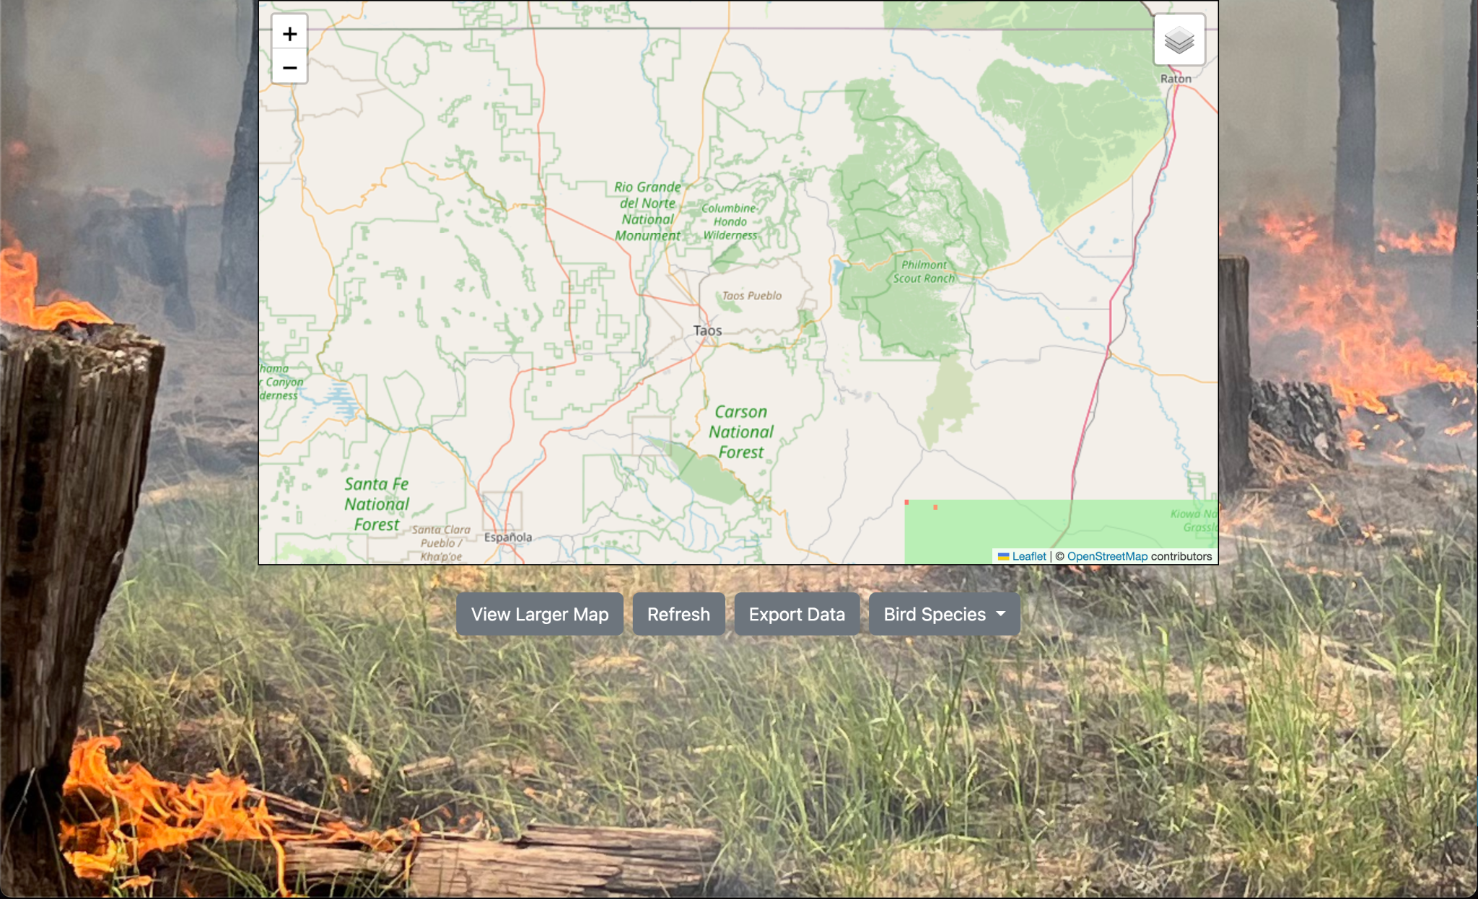
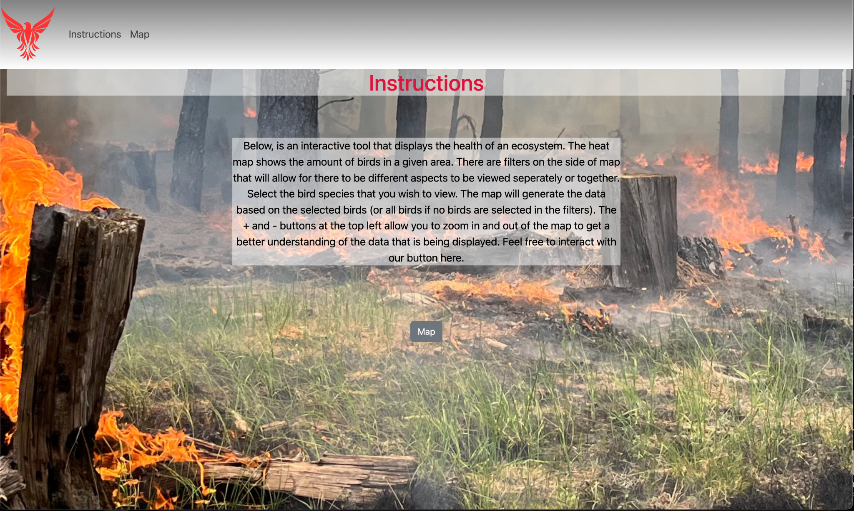
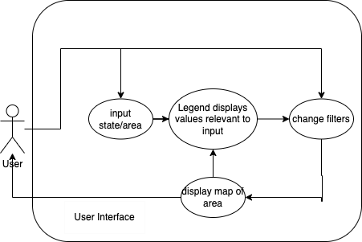
User Interface
Use navbar to navigate site
Zoom in and out of map
Export data into a csv file
Apply filters for bird species
Notes:
Andy
Time: ~30-45 seconds (current time is around 1min & 5sec)

Slide 7
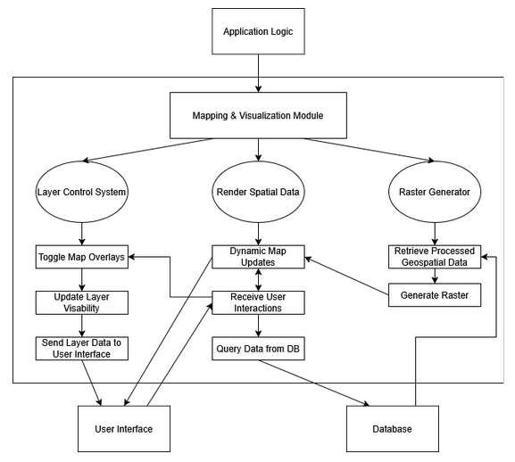
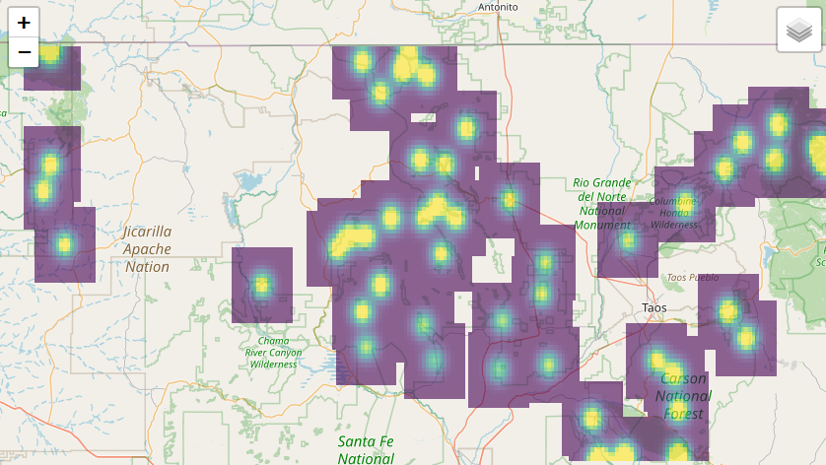
Mapping & Visualization Module
Receives data in GeoJSON format
Use Raster.io library to transform data into raster format (GeoTIFF)
Folium library to render and embed interactive web-based map
Data is shown as a heatmap to highlight bird species presence
Dynamic map updates
Notes:
Tyler
Time: ~30-45 seconds
First, receives GeoJSON data from the database.
Uses Raster.io to convert raw data into raster format
Folium to create interactive web maps.
Displays data as a heatmap to show likelihood of bird presence, as seen on the bottom right of the slide
Supports dynamic updates from filters chosen by the user like by year and species

Slide 8

Application Logic
Django custom & built-in commands:
  Run server
  Manage GET and POST requests
  URL endpoints & routes
  Define database models
  Read in data from CSV into database
  Export rendered data as CSV and map image
  Object-Relational Mapping query handler
Transform filtered data into GeoJSON format
Notes:
Tyler
Time: ~30-45 seconds
Django Framework:
Django serves as our back-end framework
Manages URL routes and HTTP requests
Reads CSV data into our database by Django models
Export filtered data as CSV files and map images
Uses Object-Relational Mapping (ORM) to simplify database querying
Transforms filtered data into GeoJSON format for integration with the visualization module

Slide 9
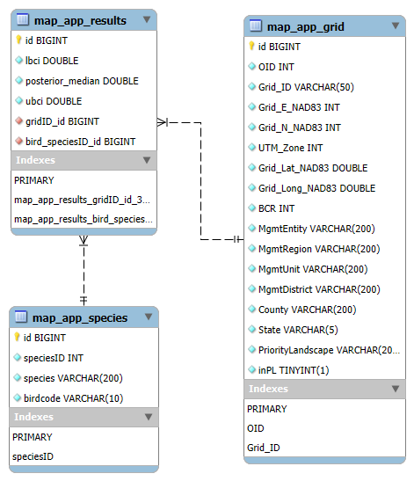
Database Layer
MySQL Database
Interfaces with Django
3 main data tables:
  Bird information
  Location details
  Results table
Notes:
Alyssa
Time: ~30-45 seconds (current time is around 42sec)
We are using a MySQL database to store all of our data for this application.
Django works directly with the database, so all we have to do is create the models, and import the data from csv files
We use main 3 tables in our database:
The first is the species table, which contains all the different species of birds data is collected on.
The second is the grid table, which contains details about all the different surveyed locations that bird data is gathered from.
The third table contains the calculated likelihood of each species in the first table in each location in the second table.
We use the data from this table for our visualizations and exports.

Slide 10
Challenges and Resolutions
Adding custom buttons to Folium generated maps
  Potential Solution: Add code to generate custom buttons into map generation code
Heat map visualization accessibility to individuals with color vision deficiencies
  Potential Solution: Accessible color palette for heat map
Seamless transfer to clients
  Potential Solution: Detailed instructions for setup, use, maintenance, and error handling
Notes:
Alyssa Slow down!!!!
Time: ~1- 2 minutes (current time is 1min & 15sec)
Currently, we have a few ongoing challenges with our project.
We are struggling to add custom buttons and options to our displayed map, especially when it is in full screen view.
Since we are using Folium to generate our maps automatically, we need to add our custom buttons into the code that generates the maps, to make sure they are totally integrated and work with the map.
We also need to ensure that our heat map visualizations are accessible to to individuals with color vision deficiencies, such as red-green color blindness.
To make sure that everyone is able to view and understand our heat maps correctly, we are planning on utilizing an accessible color palette that specifically caters to color-blind people.
Because of the major restructuring of the US Forestry Department currently happening, it is very likely that our clients will end up setting up and managing the website by themselves.
Because our clients are not very familiar with web development and hosting websites, we need to create detailed documentation and instructions to ensure that they are able to properly set up, use, maintain, and fix any errors that may show up.

Slide 11
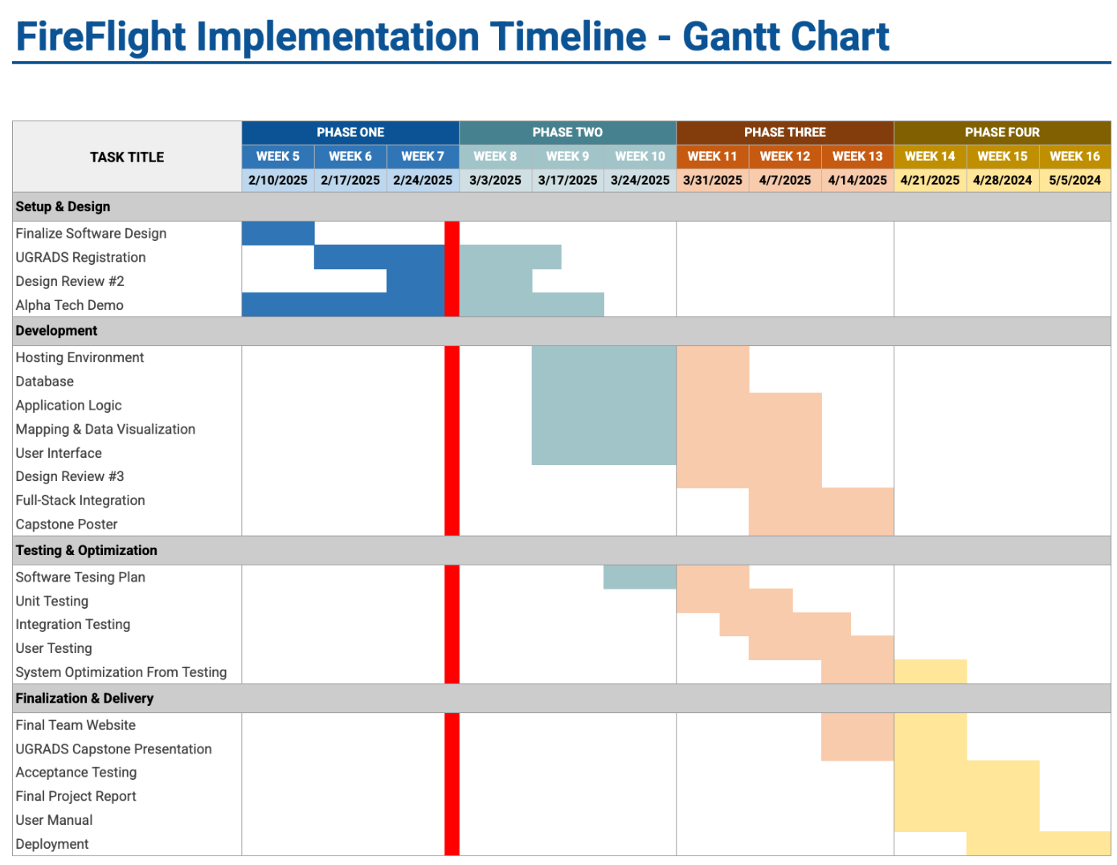
Schedule-
Notes:
Andy
Time: ~ 1 minute (current time is about 30sec)
Mention multi-testing

Slide 12
Conclusion
A user friendly tool is needed to easily view and export the data on bird presence in an area after a fire occurs
Our goal is to produce this useful tool
With focuses on UI, Mapping, Application logic, and a database layer, we want to ensure that our tool works with our clients requests
Despite some challenges that we face, we are on track to deliver a useful product
Notes:
Andy
Time: less than a minute (<60) (current time is about 35-40sec)

Slide 13
Any Questions?
Notes:
Alyssa

